Slide 1
GSKY – Accelerated Pyramid
Presentation and Technical Documentation
To enhance the user experience and reduce the server load when displaying DEA satellite layers via TerriaMap.
Copyright © 2019 by National Computational Infrastructure, Canberra, ACT, Australia. Author: Dr. Arapaut V. Sivaprasad.
24 July, 2019

Slide 2
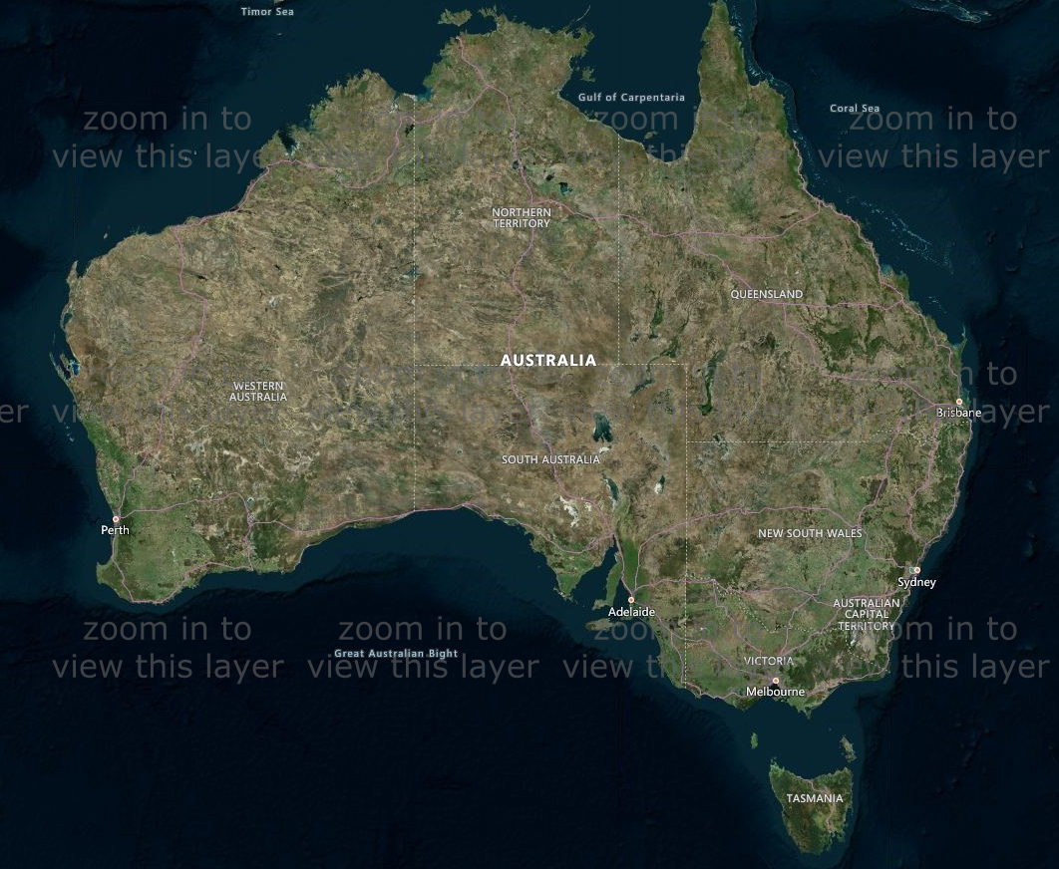
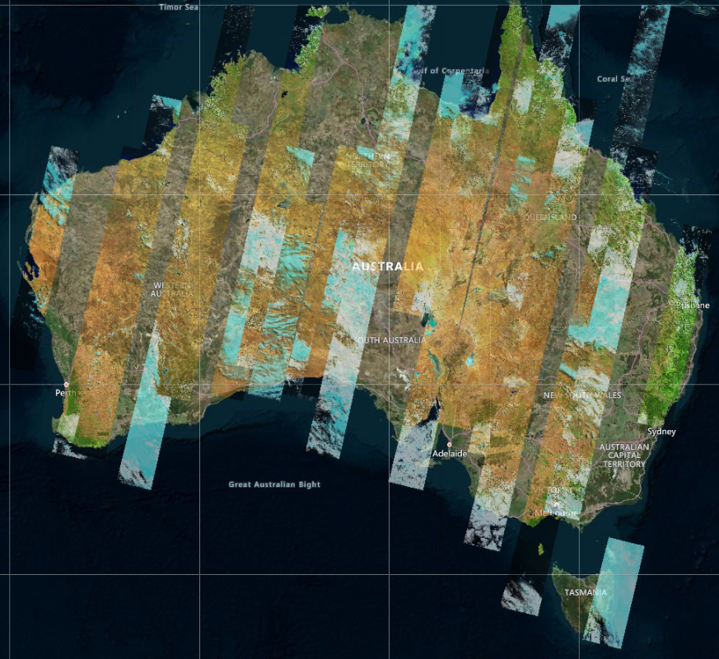
Introduction
GSKY creates composite PNG images from NetCDF files.
It can process only small areas.
Large areas result in a timeout.
No continent-wide view is possible.
We are trying to make the following possible…

Slide 3
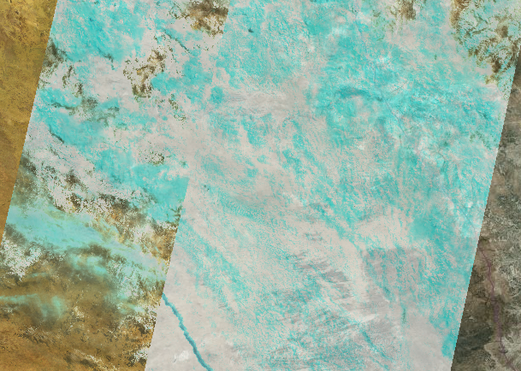
Introduction
Currently to view any data…
Must zoom in to 50km or less zoom level.

Slide 4

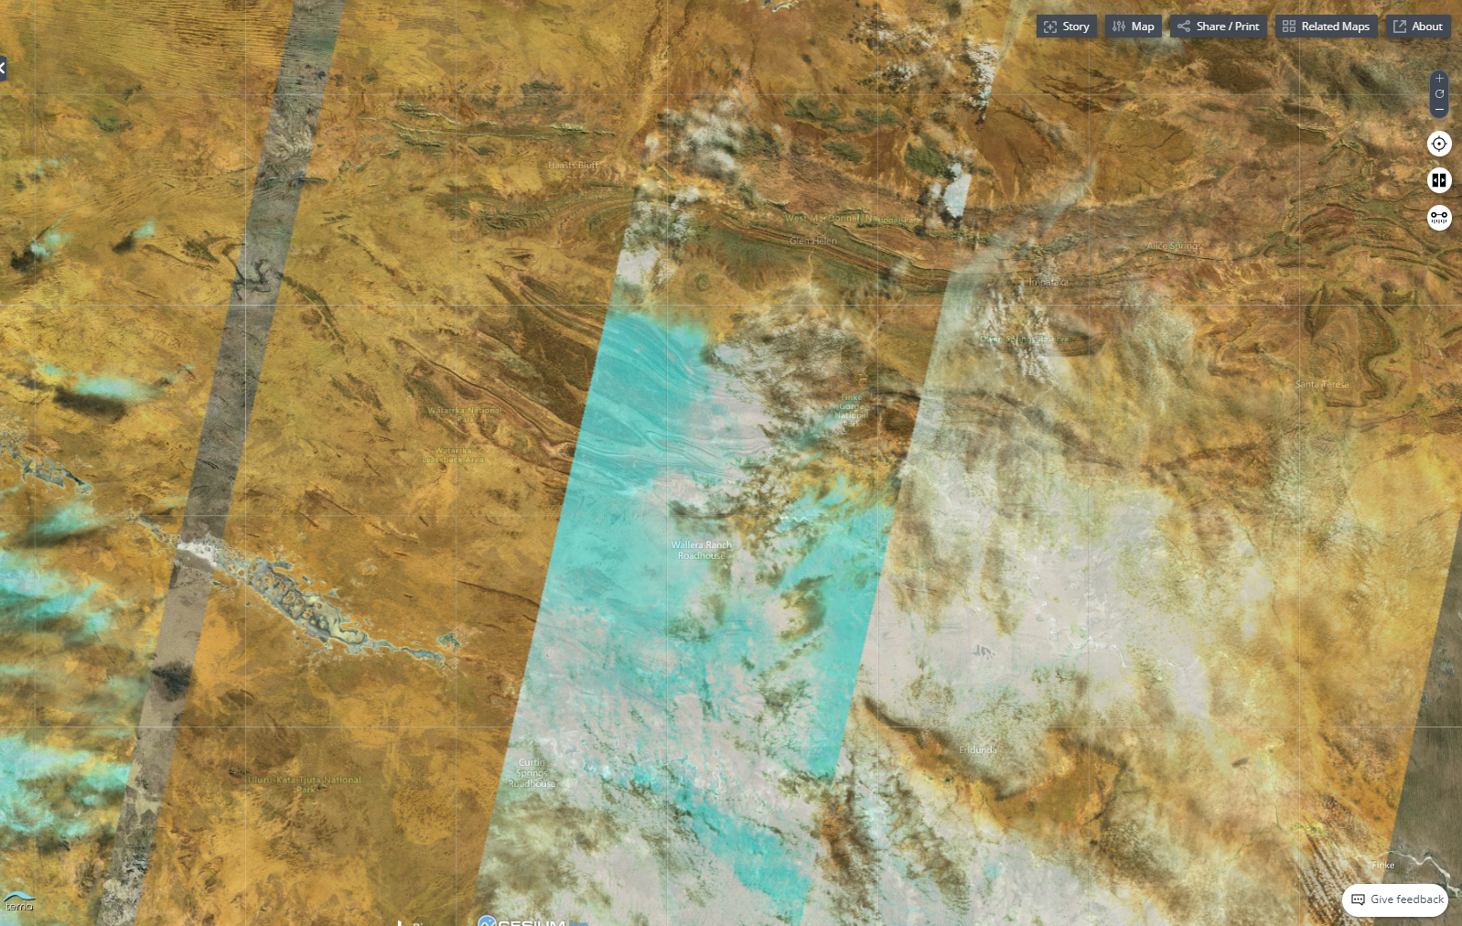
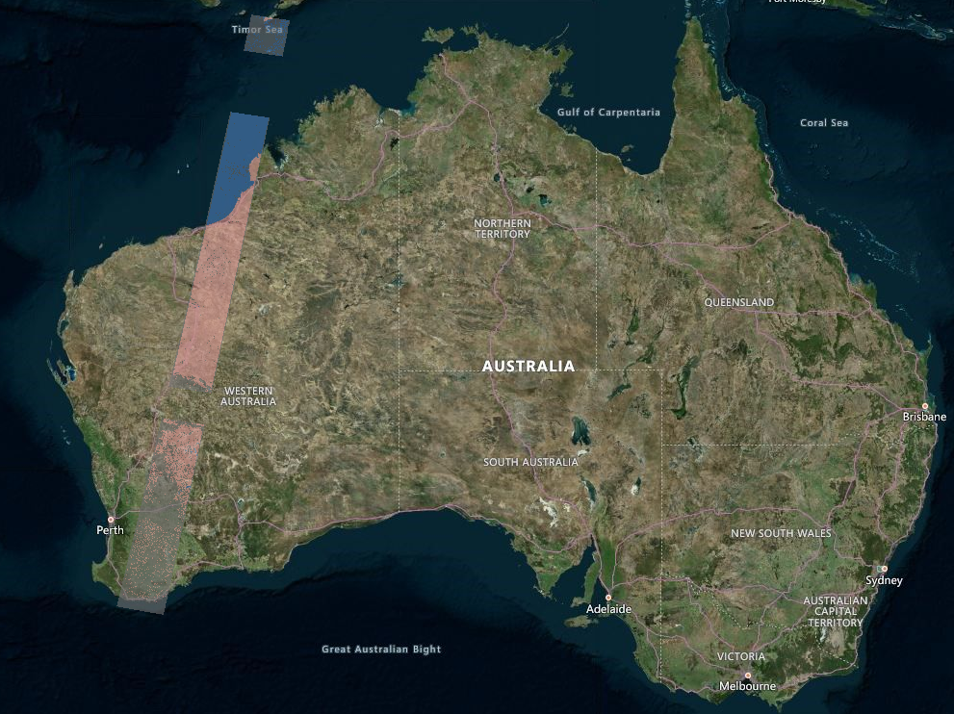
Objectives
We must be able to view the swaths at all zoom levels.
Then, it must be possible to zoom in for greater details.
On the left is a continent-wide display on which it is easier to draw a bounding box to zoom in.
When the data is sparse it becomes even more useful to have a continent-wide display.

Slide 5
Benefits
Fast display.
Better user experience.
Reduced server load.
>> Demo
http://130.56.242.6/terria/
http://130.56.242.15/ows/ap

Slide 6
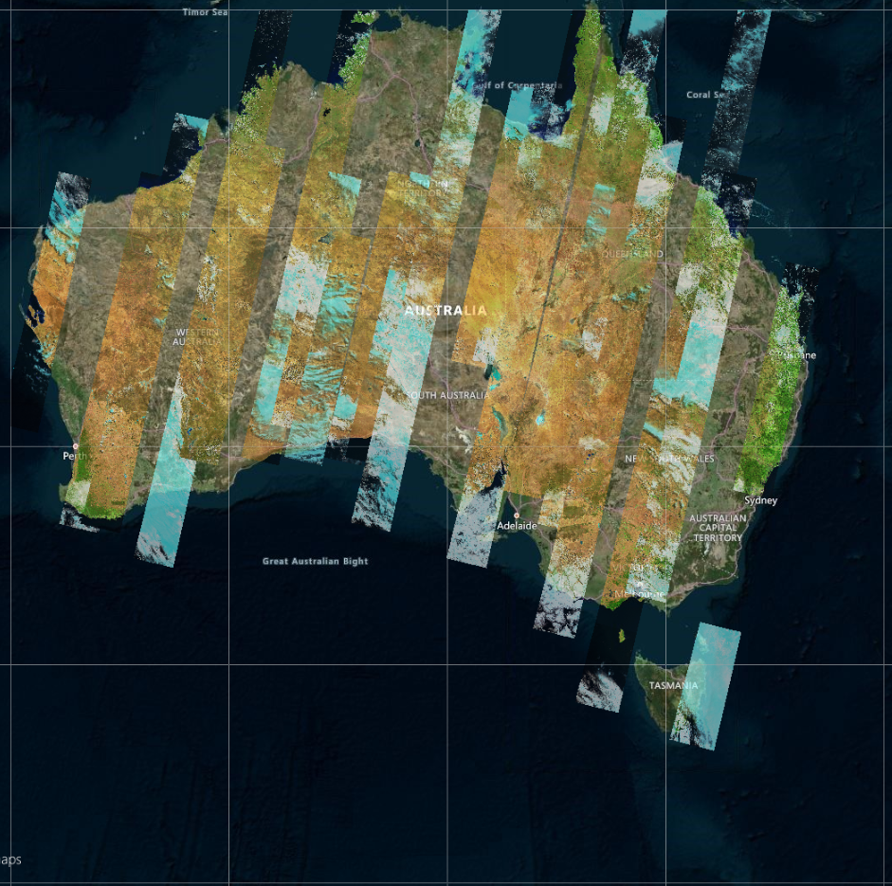
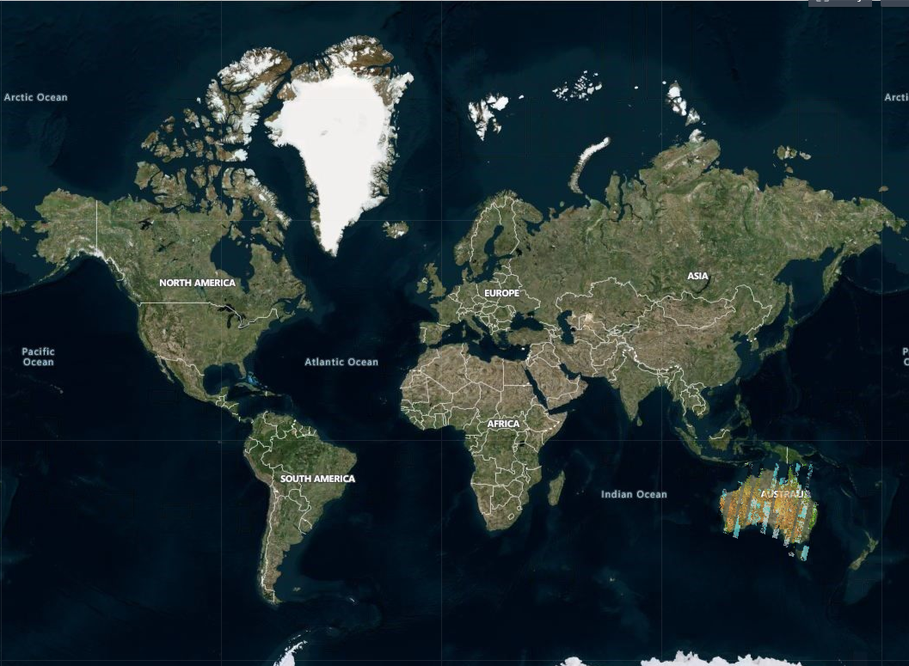
Methodology
Caching the images as *.png files.
TerriaMap divides the map into tiles…
1 tile to cover Australia at world-level zoom.
14 tiles at continent-level zoom
Tiles are divided into 4 at each zoom level
1
2
3
4
5
6
7
8
9
10
11
12
1
13
14

Slide 7
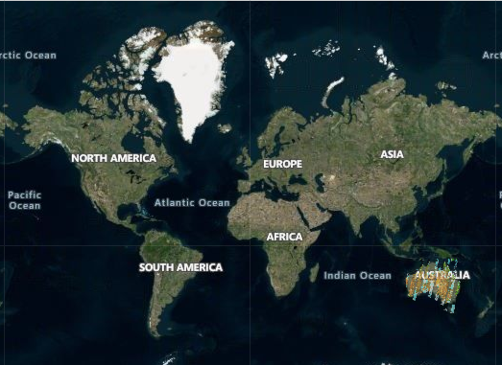
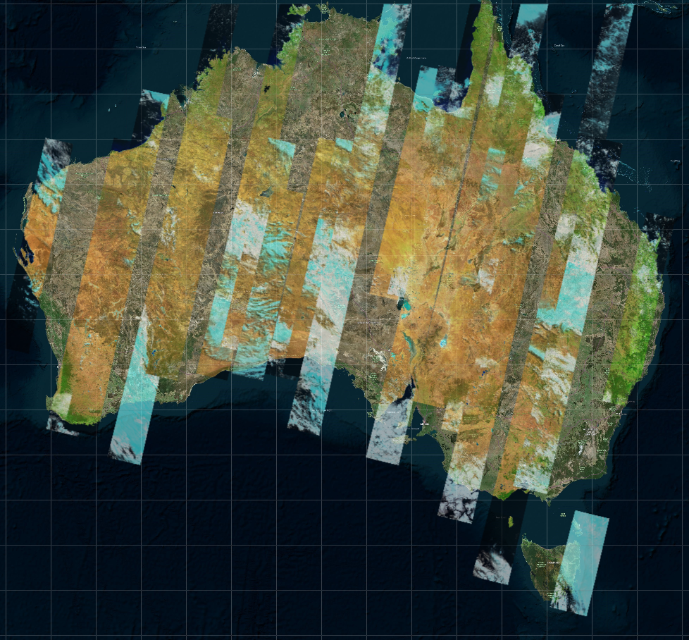
Methodology
Tiles at zoom levels 5,000km to 10km (10 levels) are cached.
16,384 tiles at 10km zoom.
Tiles increase to >1 billion at the highest zoom level of 50m.
Impractical to cache all zoom levels.
5,000km : 1tile
3,000km : 1
1,000km : 3 tiles
500km : 6
300km : 14
200km : 64
100km : 256
50km : 1024
20km : 4096
10km : 16,384
5km : 65,536
3km : 262,144
1km : 1,048,576
500m : 4,194,304
300m : 16,777,216
200m : 67,108,864
100m : 268,435,456
50m : 1,073,741,824

Slide 8
Methodology
GSKY server code is modified to save the output as PNG file.
Prepared a list of bounding boxes for zoom levels 5,000 km to 10 km.
Sent these BBOXes via ‘curl’ to GSKY server to get the tiles.
Time varied from < 1 to 300 seconds per tile.
Total for one time slice: ~3 hours
Expecting this to average out as 1 hour.
Total time slices: ~16,000
Total execution time: ~16,000 hours (16 KSUs in parallel or 1.8 years in serial)
Working on parallelizing the process on Raijin
Aiming to reduce the total time to < 12 hours
Time slice storage: ~1GB
Expecting this to be an average of 400MB per time slice
Total storage: 6.4TB

Slide 9
Technical Details
GSKY code change to cache the tiles
ows.go is set to write the PNG to a file instead of to the web.
create_tile = flag.Bool("create_tile", true, "For Google Earth Web Service.")
if(*create_tile) { // AVS: Write it in a local file.
ts := fmt.Sprintf("%v",*params.Time)
date := strings.Split(ts, " ")
s := fmt.Sprintf("%.8f_%.8f_%.8f_%.8f", params.BBox[0],params.BBox[1],params.BBox[2],params.BBox[3])
tile_dir := *tile_basedir + layer + "/" + date[0]
os.Mkdir(tile_dir, 0755)
tile_file := tile_dir + "/" + s + ".png" ;
f, _ := os.Create(tile_file)
defer f.Close()
f.Write(out)
return
}
SYNOPSIS: The filename for the cached tile is constructed from the bounding box values and saved in a subdir, ‘tile_basedir/layer/time’. When a call is made to the GSKY server for a bounding box, which is always the same for a partular tile but is different between zoom levels, the file is found by constructing the filename in the same way.

Slide 10
Technical Details
GSKY code change to use the cached tiles
tile_basedir = flag.String("tile_basedir", "/local/avs900/Australia/DEA_Tiles/", "Server data directory.")
use_cached_tiles = flag.Bool("tc", true, "Tiles for this time slice are cached.")
var longdiff float64
longdiff = params.BBox[2] - params.BBox[0]
if (*use_cached_tiles && longdiff > 19568.00 ) {
s := fmt.Sprintf("%.8f_%.8f_%.8f_%.8f", params.BBox[0],params.BBox[1],params.BBox[2],params.BBox[3])
tile_file := tile_dir + "/" + s + ".png" ;
if _, err := os.Stat(tile_file); err == nil {
ReadPNG(tile_file, w)
return
} else {
tile_file := *tile_basedir + "blank.png"
ReadPNG(tile_file, w)
return
}
}
NOTES: The ‘longdiff’ is the difference between longitudes 1 and 2 (MinX and MaxX) in the BBOX. Its value will get smaller as the zoom level increases. The 5km level has the longdiff of 19567.879241 and will skip the cached tiles. Skipping the block for using the cached tiles will let the execution to get the GSKY data directly. This enables the display of data at zoom levels below 10km. If within the right zoom level, but no tile is found in cache, a transparent tile (‘blank.png’) is used. This logic eliminates the need to check whether a tile is blank or not. During the creation of tiles the blank tiles will be created for tiles that are in, say, the ocean or if they do not have any data. These blank tiles are deleted to save disk space.
func ReadPNG(tile_file string, w http.ResponseWriter) {
file, err := os.Open(tile_file)
if err != nil {
tile_file := *tile_basedir + "blank.png"
ReadPNG(tile_file, w)
}
defer file.Close()
out, err := ioutil.ReadAll(file)
w.Write(out)
}

Slide 11
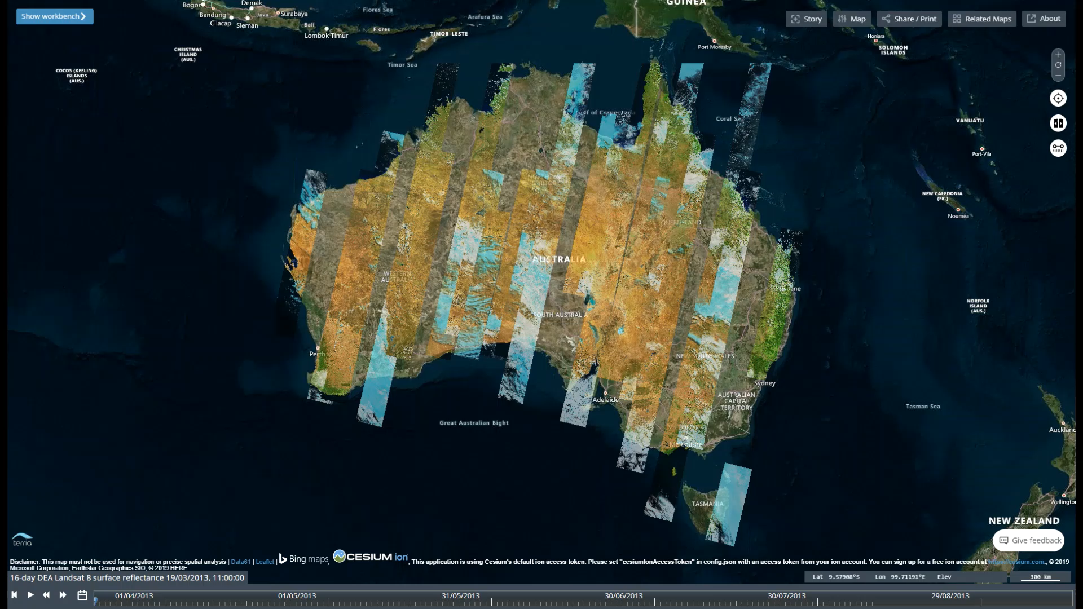
Further Work
Collect tiles at 10km or 5km zoom levels alone.
Concatenate the PNG files to create larger tiles.
May reduce the time to ~30 min per time slice.
These are just thoughts:
ArcGIS/QGIS:
Find a way to use time parameter in WMS query.
Possible use of KML files to do this.
Alter TerriaMap and GSKY to create/download KMLs.
Let ArcGIS read the KMLs (much like Google Earth).
NetCDF subsets:
Let GSKY save the tiles as NetCDF (WCS).
TerriaMap to download the NetCDFs (already possible?)
ArcGIS to read the NetCDFs.
Python code:
Develop Notebooks with useful Python code for analyses.
Animating GSKY output like a video.

Slide 12






Acknowledgements

